Slide 1

Note: The data and information in this document is reflective of a hypothetical situation and client. This document is to be used for KPMG Virtual Internship purposes only.
Sprocket Central Pty Ltd
Data analytics approach
Chennai - Srinivasan, Pechumani, Kamalesh

Slide 2
Note: The data and information in this document is reflective of a hypothetical situation and client. This document is to be used for KPMG Virtual Internship purposes only.
Agenda
Introduction
Data Exploration
Model Development
Interpretation

Slide 3
Note: The data and information in this document is reflective of a hypothetical situation and client. This document is to be used for KPMG Virtual Internship purposes only.
Introduction
New Customers Analysis
Analyze the following factors for new customers:
Age distribution criteria
Bike Purchase in 3 years
Job Industry Category
Car owns by the new customer

Slide 4
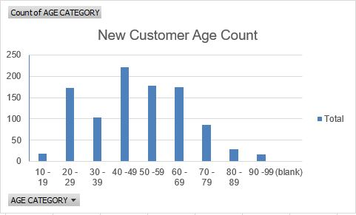
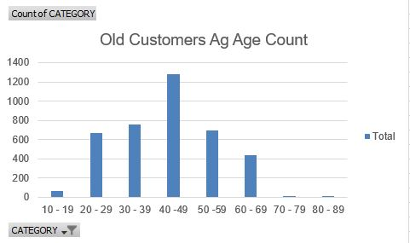
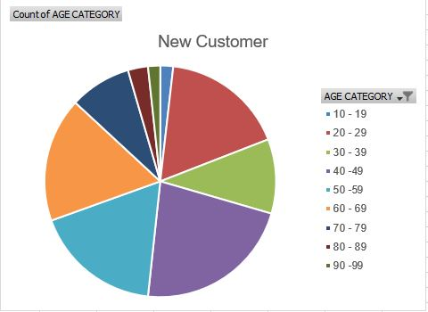
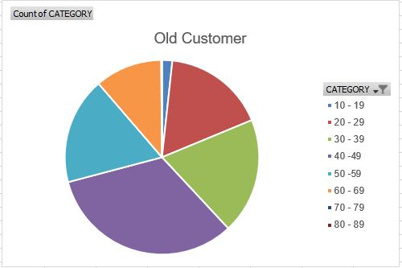
Note: The data and information in this document is reflective of a hypothetical situation and client. This document is to be used for KPMG Virtual Internship purposes only.
Data Exploration
Plots of Age Distribution for New Customers Plots of Age Distribution for old Customers

Slide 5
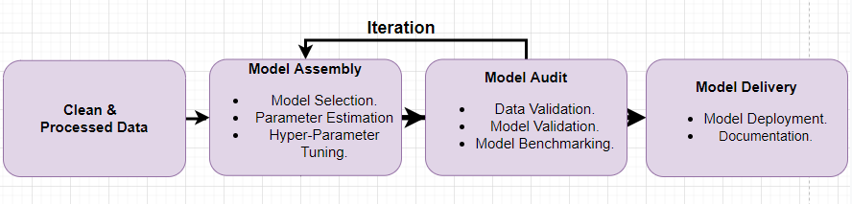
Note: The data and information in this document is reflective of a hypothetical situation and client. This document is to be used for KPMG Virtual Internship purposes only.
Model Development
Model Development
Model development is an iterative process, in which many models are derived, tested and built upon until a model fitting the desired criteria is built.
Fig. Model Development Steps.
The Initial step is to determine a hypothesis questioning the problem statement and then perform statistical testing to determine if the hypothesis is valid or not.
Evaluate the performance of the models using factors such as ROC Curves, Precision, Recall, AUC Curve, Accuracy, F1-score etc.
Finally, deploy and document the best model’s performance, assumptions and certain limitations.

Slide 6
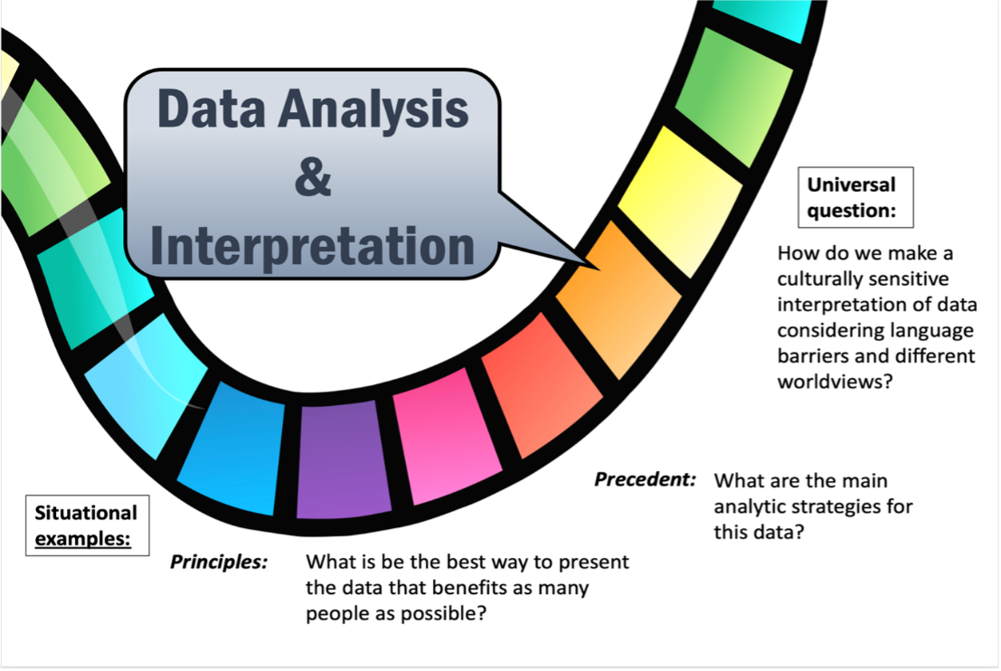
Interpretation
Data interpretation is the final step of data analysis where we turn results into a presentable format to gain clear and useful insights for business strategies.
Quantitative and qualitative methods are distinct types of data analyses both offering different type of data interpretation & decision making abilities.
Data dashboards decentralize data without compromising on the necessary speed of thought while blending both quantitative and qualitative data.
We will be reporting the insightful findings in the form of a dashboard which will demonstrate the Customer Demographic , Target Customers, Top Selling Goods etc. to help the team to make appropriate business decisions.
Fig. Data Interpretation techniques.

Slide 7
Note: The data and information in this document is reflective of a hypothetical situation and client. This document is to be used for KPMG Virtual Internship purposes only.
THANK YOU

